Slide 1

Machine Learning Algorithms to Correct Images to Help the Color Blind
Jimmy Hickey
Winona State University
April 25th 2018

Slide 2
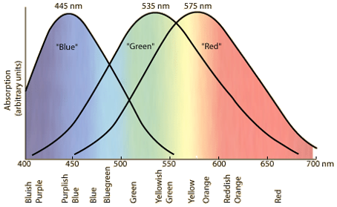
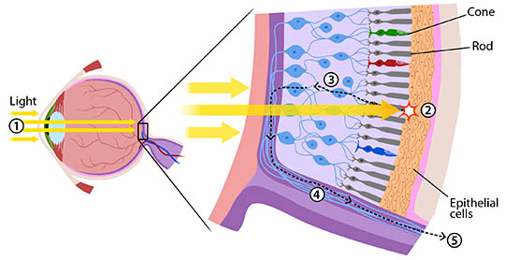
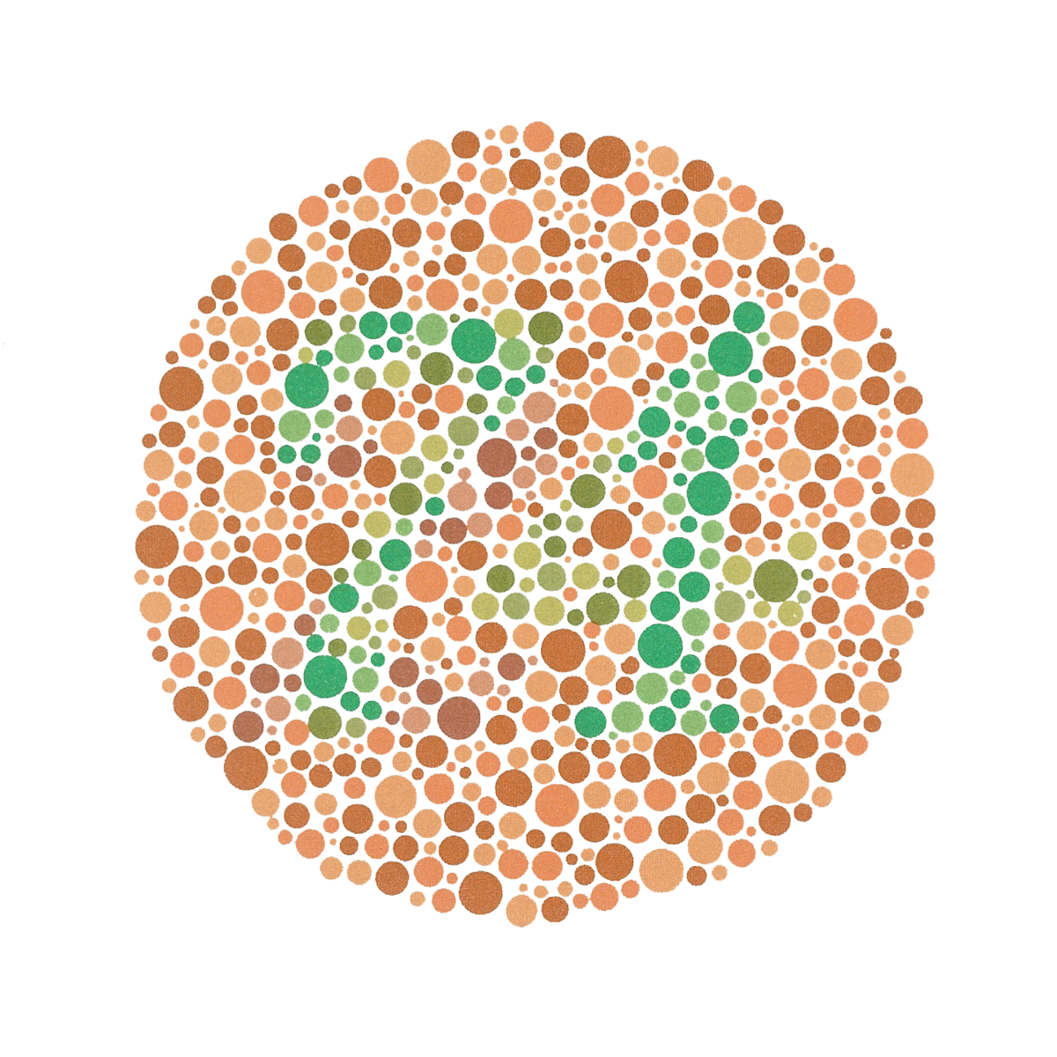
Color Blindness
We can still see colors!
https://askabiologist.asu.edu/rods-and-cones
http://hyperphysics.phy-astr.gsu.edu/hbase/vision/colcon.html
https://en.wikipedia.org/wiki/Ishihara_test

Slide 3
Current Solutions
Glasses
Gene Therapy?

Slide 4
Goals
Identify colorblind problem areas
Correct these issues without losing much information

Slide 5




Data Creation
Data created rather than using Ishihara test
Drawn using Adobe Photoshop
Images with many color combinations

Slide 6
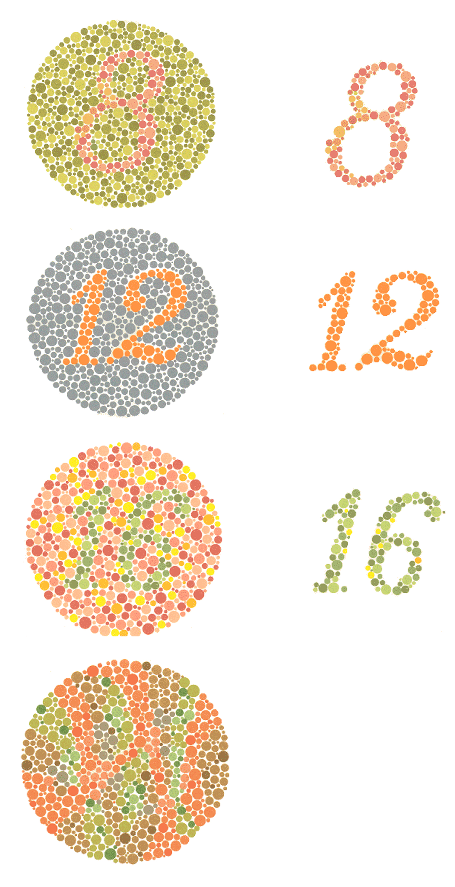
Color Detection
Unsupervised learning pattern recognition
Examine RGB value of each pixel in an image
https://chrismarkland.wordpress.com/2012/02/28/map-specific/

Slide 7


Adding Noise
mean = 0
sd = 3
np.ceil(np.random.normal(mean, sd))

Slide 8
K-Means Clustering
Randomly select a mean for each cluster.
Classify each piece of data according to each mean.
Use these new classifications to recompute the mean of each cluster.
Repeat 2 & 3 until the clusters converge.

Slide 9



K-Means Clustering
Clusters changed to black and white

Slide 10
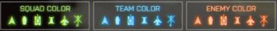
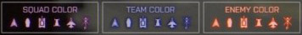
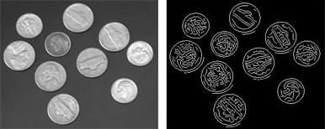
Color Correction
http://www.gamersexperience.com/colorblind-accessibility-in-video-games-is-the-industry-heading-in-the-right-direction/
Color reassignment
Edge detection
A different implementation of color reassignment.
https://www.mathworks.com/discovery/edge-detection.html

Slide 11

Color Reassignment
Slightly adjust the colors of the pixels in each cluster

Slide 12

Color Reassignment

Slide 13



Edge Detection
Draw thin edges between clusters

Slide 14
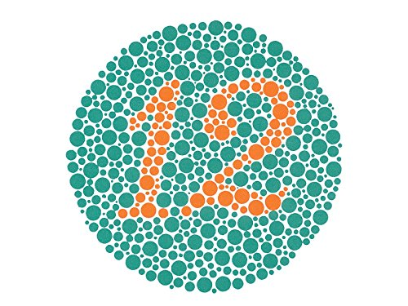
Limitations and Improvements
Non-representative data
No expert opinions
No user feedback
Supervised learning
https://www.amazon.com/KANEHARA-Ishihara-Chart-Deficiency-Plates/dp/B00MAVIR3Y

Slide 15
References
[1] Ryan Cross. 2016. How EnChroma’s Glasses Correct Color-Blindness. (June 2016). https://www.technologyreview.com/s/601782/how-enchromas-glasses-correct-color-blindness
[2] enchroma. [n. d.]. Frequently Asked Questions. ([n. d.]). http://enchroma.com/contact-us/
[3] National Eye Institute. 2015. Facts About Color Blindness. (February 2015). https://nei.nih.gov/health/color_blindness/facts_about
[4] Thales Sehn K.űrting. 2013. How K-Means algorithm works. (July 2013). https://www.youtube.com/watch?v=IuRb3y8qKX4
[5] Emily Singer. 2009. Color-Blind Monkeys Get Full Color Vision. (September 2009). https://www.technologyreview.com/s/415339/color-blind-monkeys-get-full-color-vision/
https://opendyslexic.org/

Slide 16
Acknowledgements
Dr. Zhang & Dr. Iyengar
Dr. Deppa

Slide 17
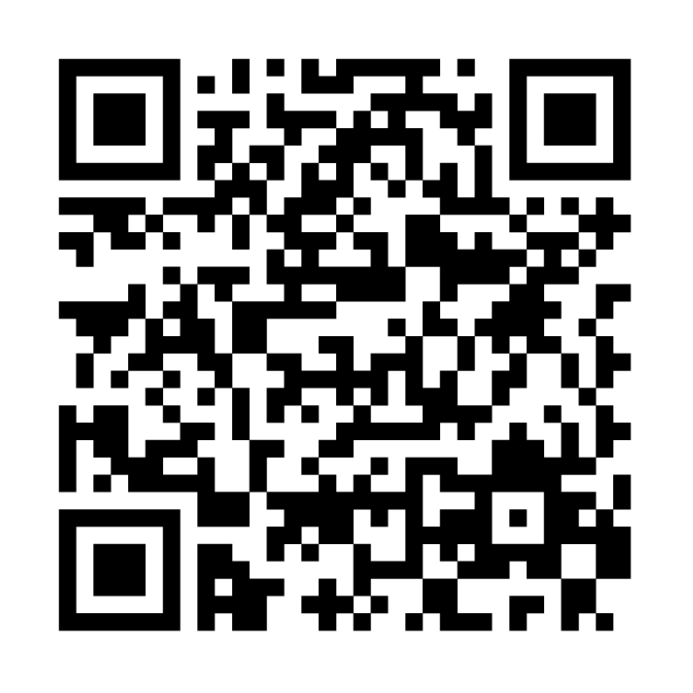
Thank you!
https://github.com/JimmyJHickey/Computer-Color-Blind-Correction

